Slide 1
AMU Connect
Minor Project – COC3950
Presented By Presented To
Inshamul Haque Dr. Tameem Ahmed
Mohammad Faizan Khan

Slide 2
Contents
Objective
Architecture Used
PERT Chart
Methodology Used
Result
Analysis
Conclusion
Future Work
References

Slide 3
Objective
The main objective of this chat application project is to:
Build a highly responsive, real-time communication platform.
Offer an engaging and user-friendly experience.
Emphasize a robust backend infrastructure.
Integrate an intuitive, modern frontend.
Ensure seamless, instant messaging capabilities.
Manage data efficiently using cutting-edge web technologies.

Slide 4
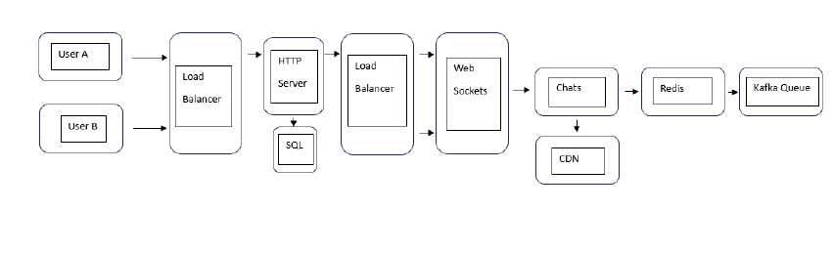
Architecture used

Slide 5
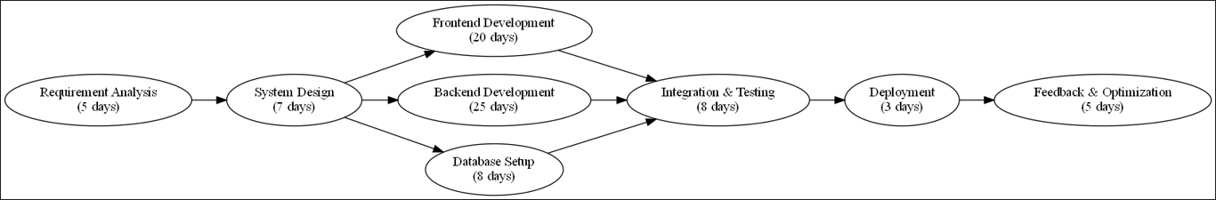
Pert chart

Slide 6
Methodology Used
Frontend Development
Technologies Used: Rect.js & Tailwind CSS
Focus: Building a responsive, interactive user interface for smooth user experience.
Backend Development
Technologies Used: Next.js
Role: Implementing server-side rendering and handling API routes to enhance performance and scalability.
Databases Used
PostgreSQL: used for secure and structured storage of user details.
Redis: enables fast, real-time access to chat messages through caching.
Real Time Communication
Tool : Socket.io
Purpose: Implementing server-side rendering and handling API routes to enhance performance and scalability.

Slide 7
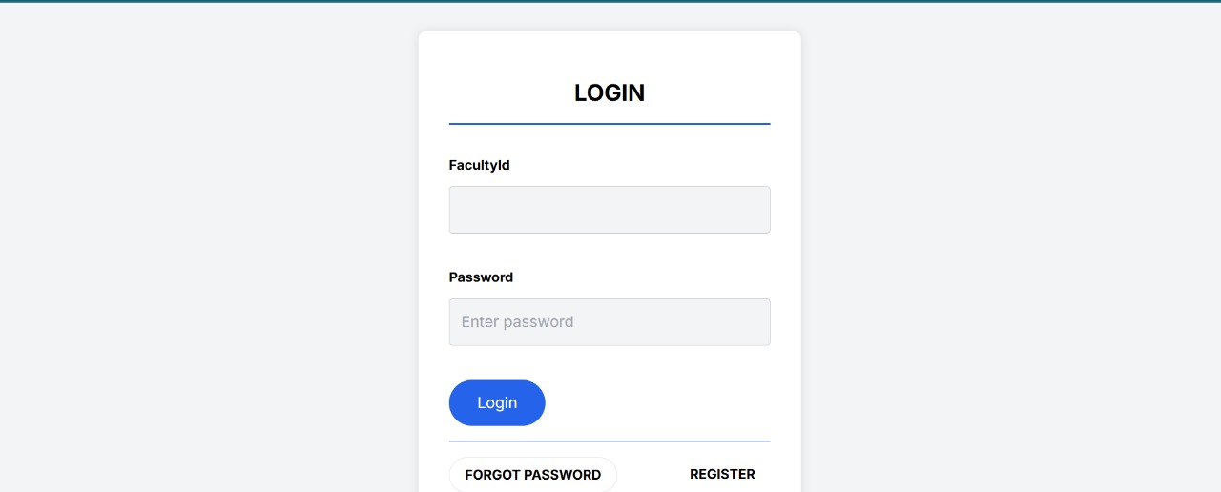
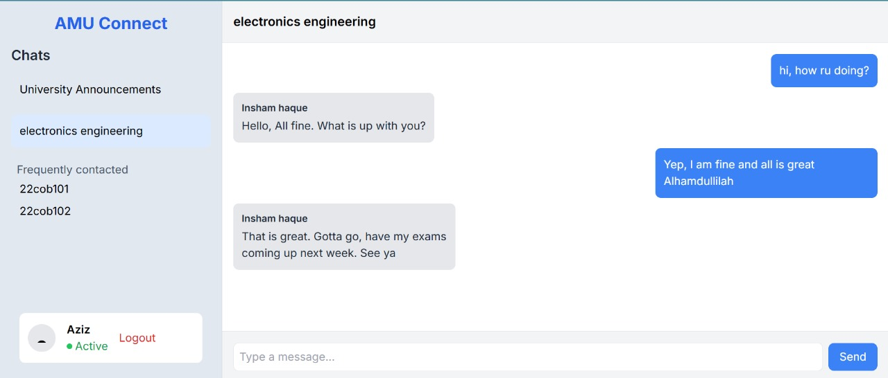
Result
Login Page
Chat Dashboard

Slide 8
Analysis
Challenges Faced
Handling high concurrency and ensuring real-time updates for multiple users.
Managing schema design in PostgreSQL to store user details and chat history efficiently.
Debugging complex state management in React.js for seamless frontend interaction.
Lessons Learned
Importance of selecting the right database for specific needs (PostgreSQL for persistence, Redis for speed).
The value of version control and collaborative development using GitHub.
Effective use of Next.js improved server-side rendering and API integration.

Slide 9
Conclusion
Key Features Implemented
User Authentication: Secure and efficient login process with token-based authentication.
Real Time Messaging: Instant message delivery with low latency, ensuring smooth user interactions.
Optimized Data Handling: Effective use of Redis for fast access to chat messages and PostgreSQL for user data management.
Performance & Scalability
The app performs well under typical usage and it can handle a growing number of users and messages without significant performance degradation.
Redis has proven effective in improving the speed of message retrieval, making the application highly responsive.
User Experience
The application’s user interface is intuitive and responsive, ensuring a smooth experience across different devices.
Impact
The chat application provides a robust solution for real-time communication, making it suitable for both small and large user bases.
It serves as a strong foundation for future development, with potential for scaling and adding more advanced features.

Slide 10
Future work
New Features
Voice and Video Chat
Support for group chats and media sharing.
Security Enhancements
Integrate Two-Factor Authentication (2FA).
Implement end-to-end encryption for messages.
Cross Platform
Convert to Progressive Web App (PWA)
User Personalization
Custom Themes.
Expand user profiles with more options.
AI Integration
Deploy chat bots for user assistance.
Automate message moderation and filtering.

Slide 11
References
The official Node.js documentation helped in understanding server-side JavaScript, asynchronous programming, and handling HTTP requests. https://nodejs.org/en/docs/
Redis documentation was critical for understanding its architecture and how to use Redis for real-time messaging. https://redis.io/topics/pubsub
This tutorial helped implement WebSocket communication for real-time messaging and notifications in AMU Connect. https://www.digitalocean.com/community/tutorials/
This article provided practical insights on leveraging Redis to scale Node.js applications, which directly influenced the choice of Redis for AMU Connect's real-time messaging. https://medium.com/
JWT.io documentation was crucial for understanding how to implement web tokens. https://jwt.io/

Slide 12
Thank You
Inshamul Haque Mohammad Faizan Khan
gn2403@myamu.ac.in gn2444@myamu.ac.in

